Slide 1
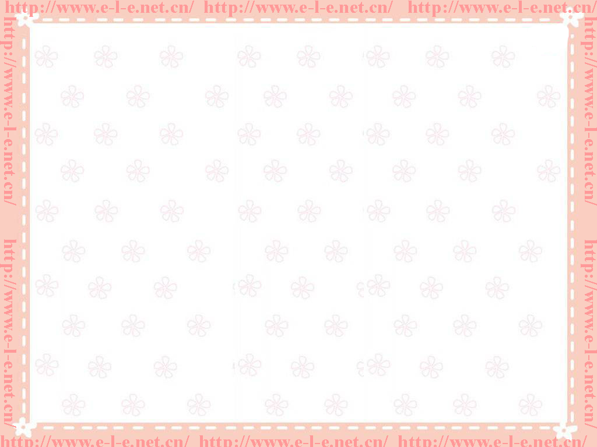
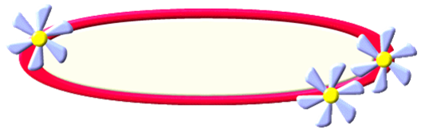
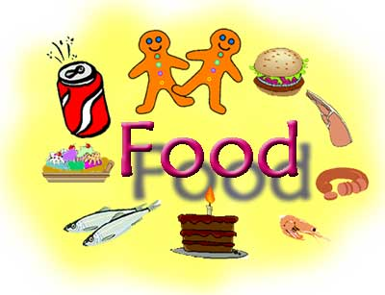
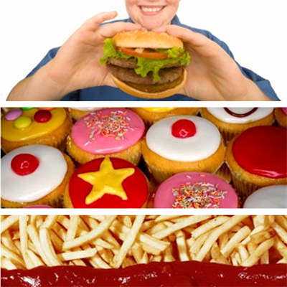


高中第八册
Module 3
Foreign Food

Slide 2
Language points

Slide 3
Passage 1
Para. 1
1. In fact, I think that they are sometimes obsessed with it.
事实上，我觉得他们有时候对此到了痴迷的程度。
be obsessed with/by “痴迷, 迷住”; “牵挂, 困扰”
He was obsessed with computer games a year ago.
一年前他迷上了电脑游戏。

Slide 4
My father is obsessed with lottery and talks about nothing else.
我爸爸迷上了彩票, 别的什么也不谈。
He was obsessed with the ideas that he was being watched.
他总觉得受人监视而心神不宁。
She was obsessed with the fear of death throughout her old age.
她晚年一直受着死亡恐惧的困扰。

Slide 5
2. I had eaten Chinese food often, but I could not have imagined how fabulous a real Chinese banquet could be.
我以前也经常吃中餐,但从没想到真正的中式宴席会那么丰富。

Slide 6
could have done “过去可能做了” 或“ 过去本来可以做”, 用于肯定句,否定句,或疑问句。
I could have run 100 meters in twelve seconds.
我本来可以用12秒跑100米的。
She couldn't have said such a thing.
她不可能说出这种话的。

Slide 7
3. The first six or seven dishes seemed to fill the table, with plates dangerously balanced on top of another. I thought this vast wave of food was the total number of dishes to be served, and I started eating greedily.
六七道菜好像就摆满了一桌子,危险地放在另一个盘子上面。 我认为就上这么多菜了, 于是贪婪地吃了起来。

Slide 8
with plates dangerously balanced on top of another. 为with的复合结构 with+宾语＋过去分词
balance vt.& vi (使)平稳
He can balance a ball on his finger.
他能把球稳放在手指上。
She balanced herself on one foot.
她用一只脚站稳。
to be served 表将来
The question to be discussed is very important.

Slide 9
Para. 3
1. The first time I saw a three-year-old kid cheerfully chewing a chicken’s head I had bad dreams for weeks.
当我第一次看到一个三岁的孩子高兴地啃着一个鸡头的时候， 我做了好几周的噩梦。
the first time 引导一个时间状语从句，相当于：
When I saw a three-year--old kid cheerfully chewing a chicken’s head for the first time.

Slide 10
又如： The first time I went abroad I was 12 years old.
当我第一次出国的时候， 我才12岁。
for the first time 为时间状语，如：
They met for the first time at the beginning of the term.

Slide 11
Para. 4
1. be on a recent trip to 最近到……的旅行
pulling at 分词做伴随状语。
1）拉，拖 pull at the door
2）吸（烟），从（瓶里喝）pull at a cigarette
2. He must have thought I was joking.
他一定认为我在开玩笑。
must have done一定做了某事, 对过去的推测。

Slide 12
Para. 5
The name says it all.
从名字上就可以看出来。
A horrible black substance that looked and smelled about as appetizing as a burnt tennis shoe.
令人恐怖的黑乎乎的一团，看起来，闻起来都像一只烧焦了的网球鞋。

Slide 13
Passage 2
Para. 1
I was amazed at their easy and graceful manner while I stood there feeling somewhat confused by the food.
我惊讶于他们闲适优雅的举止，而我却站在那儿对他们的食物感到有些茫然。

Slide 14
amaze vt “使……惊讶”
Her knowledge amazed me.
他的学识令我惊讶。
be amazed at 对……吃惊
somewhat adv, “稍微，有点，有些”
I was somewhat surprised.
我有点惊讶。
He answered somewhat nervously.
他回答时有些局促不安。

Slide 15
It was quite hard to make out what they contained.
很难弄清楚他们里面是什么。
make out
1) 看清；听清；辨认清楚
I could just make out a figure in the darkness.
黑暗中我只看出了一个人的轮廓。

Slide 16
I could hear voices but I couldn’t make out what they were saying.
我能听到说话的声音，却听不清楚他们在说什么。
2) 理解，明白事理
I can’t make out what she wants.
我不明白她想要什么。

Slide 17
3. The Chinese have a fixed phrase ‘‘cold leftovers ”.
中国人有个成语叫“残羹冷炙” 。
It is somehow fixed in my mind that my fate and that woman's are intertwined.
She was so frightened that she could not fix her thoughts on anything.

Slide 18
Para. 2
1. It seemed to be just a bowl of grey liquid and it was only after I had tasted that I knew it was actually cooked with mushroom.
看起来就是一碗灰色的汤，直到我品尝过后我才知道确实是用蘑菇做的。
此句为强调句型，强调部分为“only after I had tasted”。

Slide 19
2. The food here goes against the Chinese sense of beauty and style at the dinner table.
这里的饮食跟中国人在餐桌上的美学原则大相径庭。
go against “反对，违反，不利于”
His thinking goes against all logic.
他的思维不合逻辑。

Slide 20
Para. 3
But one thing I do admire is the polite manner in which British people eat, even if it is just a potato.
但有一件事我确实羡慕，那就是英国人吃饭的那种彬彬有礼的方式，即使是吃土豆。
do 对动词admire的强调； in which 引导定语从句；even if 即使。

Slide 21
There are few or no artificial ingredients in fusion cooking, only the purest and freshest of produce. 在多元的烹饪文化中很少或几乎没有人造的配料，只有最纯正和新鲜的制作。
在这个句子中，artificial表示“人工的、人造的”，如：artificial brain 仿真脑，artificial cell 人造细胞，artificial climate 人造气候，artificial cotton 人造棉

Slide 22
artificial 的近义词：unnatural/ false/ unreal
有时都可以表示“假的”，但侧重点不同，unnatural强调“不自然的”，false强调有欺骗性的，而unreal作为real的反义词，强调“不是真实的”。
e.g. These flowers inside the room are all artificial.
这个房间里的花全都是人造的。

Slide 23
Exercises
1. If you do not stop committing crimes, you must _______ in prison.
2. Till now, I did not find anything __________ between the two pictures.
3. Can you ________ some ingredients not used in Chinese cooking?
4. __________ you will lose, you have not a strong will to win.
end up
in common
make out
No wonder

Slide 24
5. This breaking news ______ a big panic in public.
6. Our dinner usually starts with soup and ____________ fruit.
7. The crippled people could use ________ arms or legs to help them.
8. We need to _____ our business across the world rather than domestic markets.
set off
ends up with
artificial
set up

Slide 25
Thank you

